Slide 1
SnapDragon
T.Dharani (1818113)
K.Sowndarya(1818153)

Slide 2
Exp no:11 Implementation or Routing Information Protocol (RIP)
AIM:
To write a python program to implement
Routing Information Protocol (RIP) using Bellman
Ford’s Algorithmn.

Slide 3
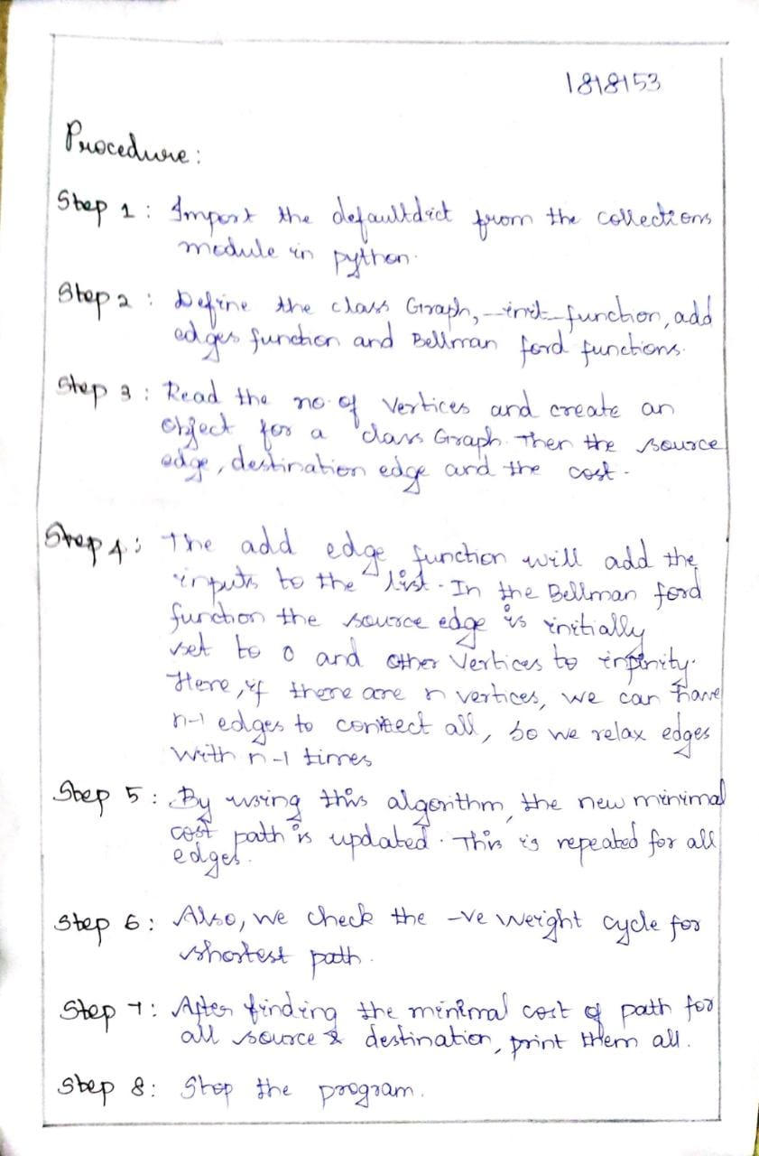
Procedure:

Slide 4
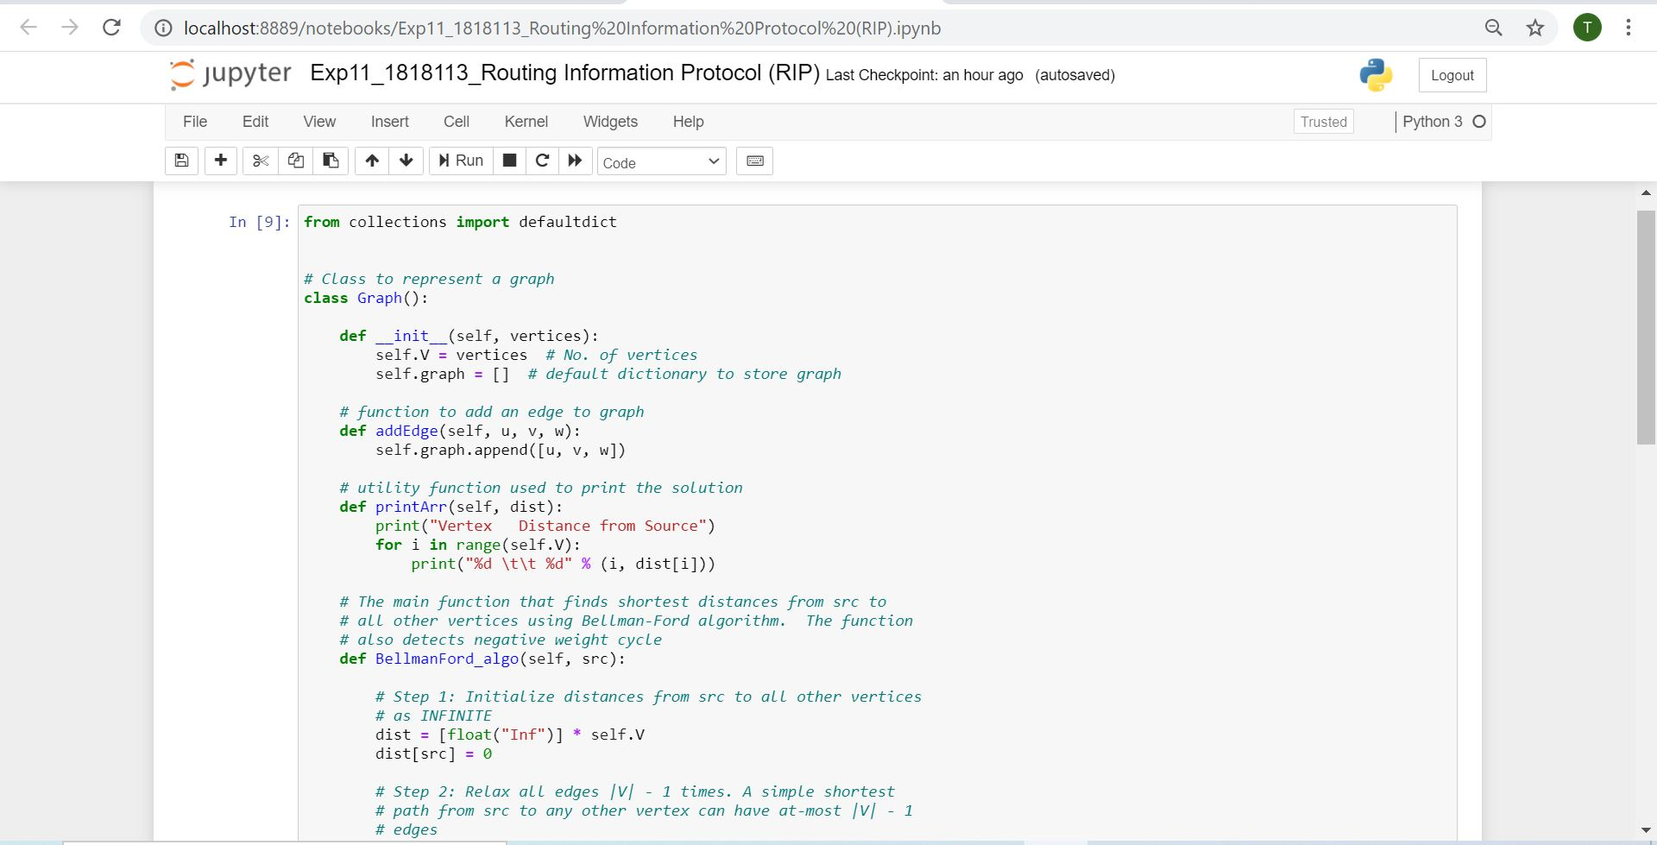
Program:

Slide 5
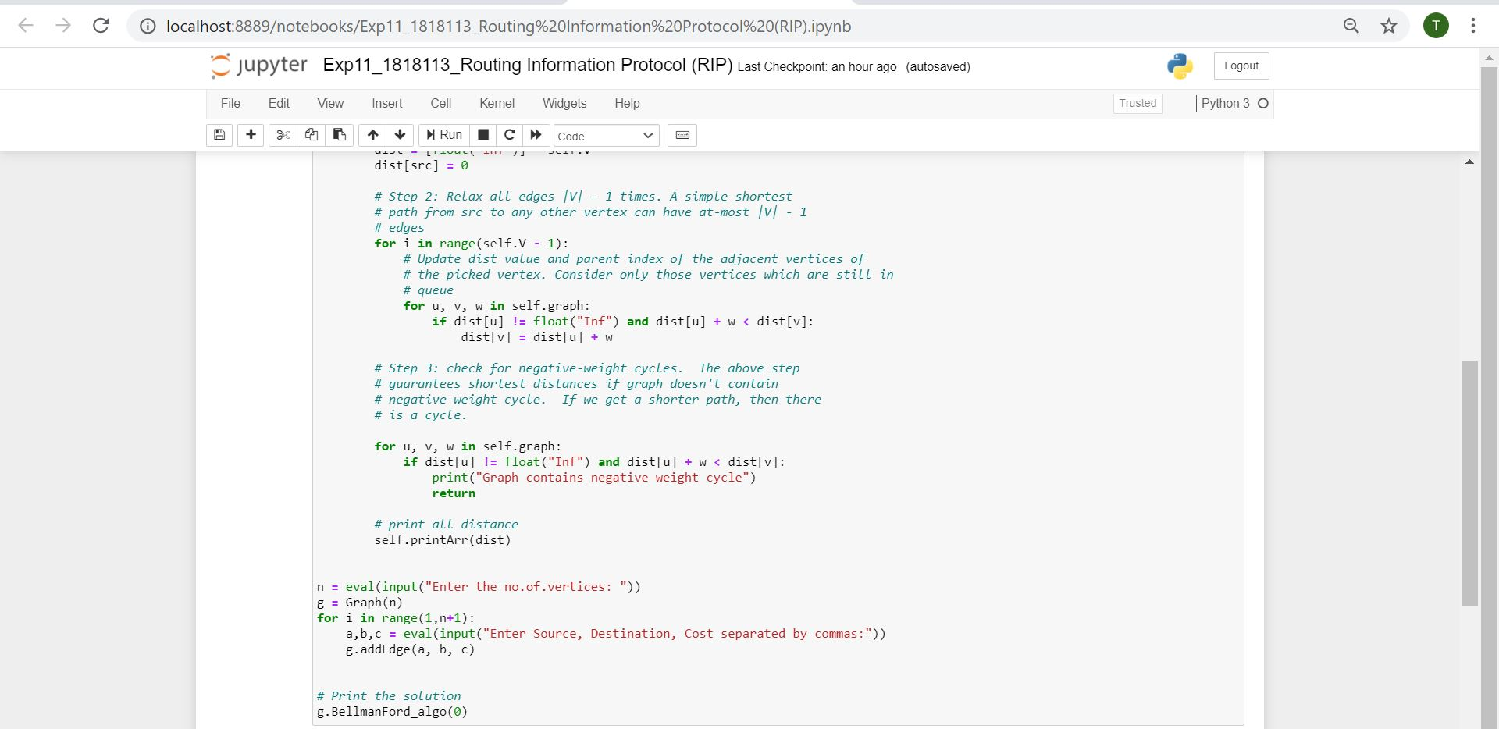

Slide 6
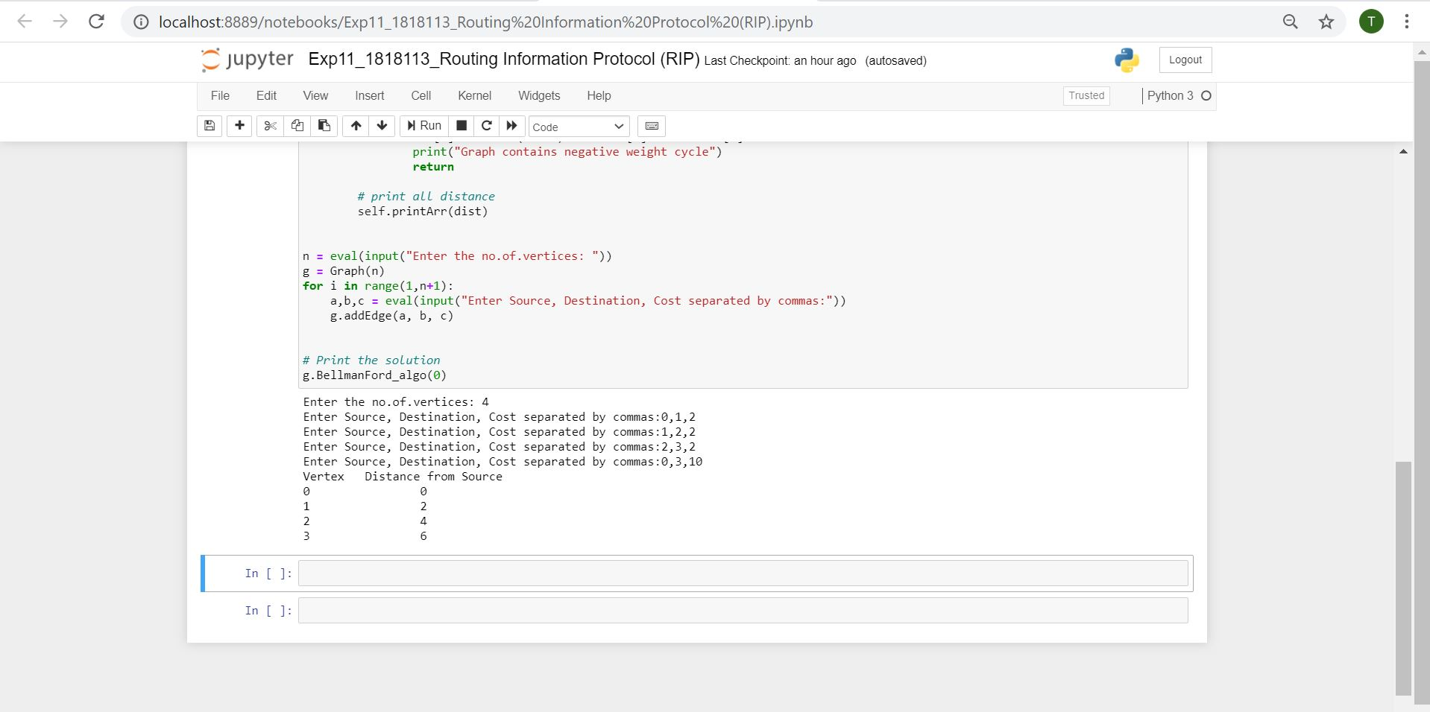
Output:

Slide 7
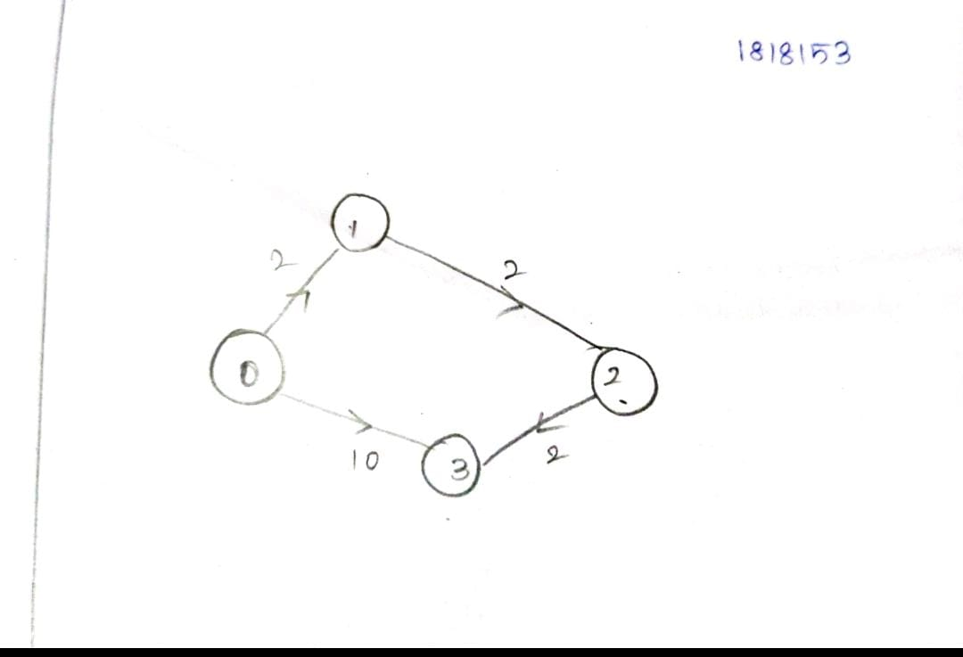
Diagram:

Slide 8
RESULT:
Thus, the Routing Information Protocol (RIP)
was implemented successfully using Bellman
Ford’s algorithm in python program.

